Slide 1

Predicting Cardiovascular Heart Disease
Caitlin Jansson
April 8, 2021
Final Report

Slide 2
TABLE OF CONTENTS
Problem Statement
Dataset
Results of Data Analysis
Machine Learning Results
Conclusions
Proposed Future Work
Thanks
References
Appendix - Additional Figures
Figures and Graphs from Data Analysis
Figures and graphs from Machine Learning

Slide 3

PROBLEM STATEMENT
Cardiovascular heart disease (CHD) is the leading cause of death annually worldwide.
Cardiovascular diseases can be managed if caught early and simple lifestyle changes are made.
The intent of this project is to explore a set of data for patients measuring known factors for heart disease to:
Develop a machine learning model to predict risk of developing heart disease within the next ten years.
Develop insights regarding CHD by exploring patient data
Make recommendations for a patient reeducation program to reduce risk of developing CHD

Slide 4
THE DATASET
This dataset is a subset of the Framingham, MA heart study data set.
This data consists of a large group of initially “healthy” patients between the ages of 30-59 who were then tracked for 20 years to determine if they developed CHD
The subset of data utilized contains information on over 4,200 patients.
43% Male
50.5% Nonsmokers
Patients ranging 32-70 years old
Data is 15% Patients At Risk and 85% patients with no risk of developing CHD in the next 10 years
Due to imbalance will have to use different tactics during model building
Find the Data Here: https://www.kaggle.com/christofel04/cardiovascular-study-dataset-predict-heart-disea

Slide 5
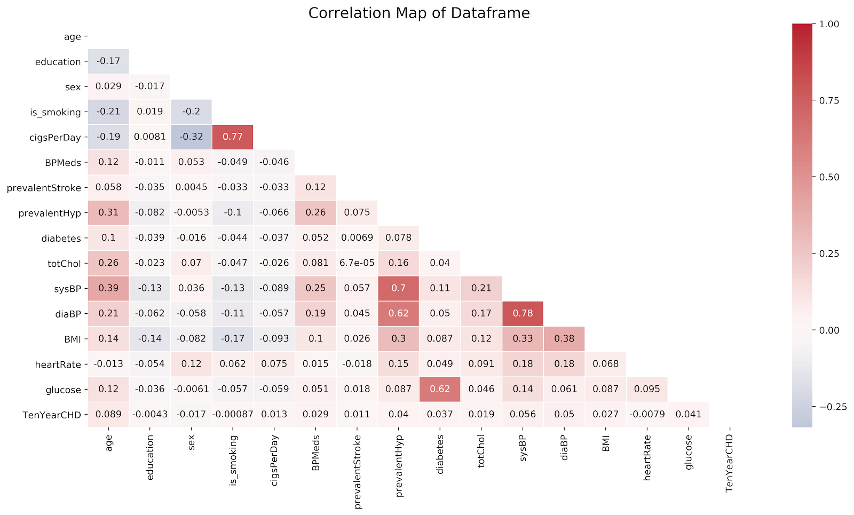
FEATURES INVESTIGATED
Age
Education Level
Gender
Smoker vs Nonsmoker
# of cigarettes smoked daily
Prevalence of
Stroke
Hypertension
Diabetes
Cholesterol
Blood Pressure
BMI
Heart Rate
Blood Sugar

Slide 6
Exploratory Data Analysis Results
The risk of developing Cardiovascular Heart Disease increases with:
Smoking, the more a patient smokes the higher the risk.
Cholesterol, and higher cholesterol means higher risk.
Blood Pressure
Prevalence of Stroke
Prevalence of Hypertension
Diabetes

Slide 7
DATA ANALYSIS CONCLUSIONS
Patient groups at highest risk, to target with reeducation material include:
Patients over 50
Males
Patients who smoke
Patients with diabetes and hypertension.

Slide 8
DATA ANALYSIS CONCLUSIONS
Recommendations for reeducation material:
Managing diet and exercise to reduce blood pressure, manage blood sugar, and manage weight can reduce risk!
Cutting back on smoking can reduce risk: even if the patient only reduces consumption.

Slide 9
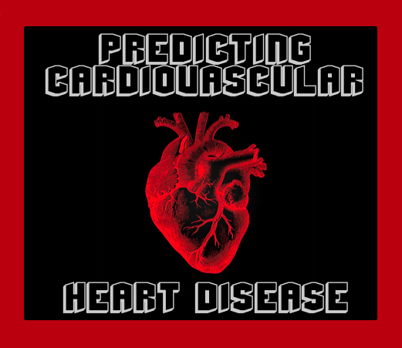
In-Depth Analysis Results

Slide 10
Multiple Models were built and Tested For Accuracy
Model accuracy was determined by comparing correct predictions and incorrect predictions.
Models were built using 2 methods: (1) using all patient data and (2) using patient data without prevalence of stroke and if a patient smokes or not
Model efficacy was determined by
(1) Least number of patients at risk incorrectly categorized, and
(2) Least number patients not at risk incorrectly categorized
(3) Correctly categorized patients

Slide 11
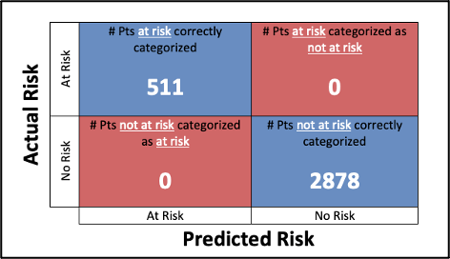
Model Results and Use
Most important metric!
2nd most important metric!
Notes:
Overall model accuracy was determined using a combination of the confusion matrix results and the accuracy score (as a percentage).

Slide 12
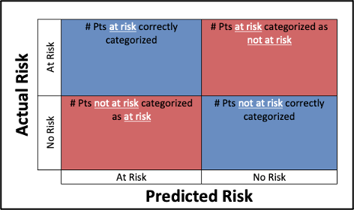
Model Results and Use
Recommend these patients for immediate lifestyle change
Consider additional measures as patient is AT RISK
Recommend these patients for immediate lifestyle change-
Notes:
Overall model accuracy was determined using a combination of the confusion matrix results and the accuracy score (as a percentage).

Slide 13
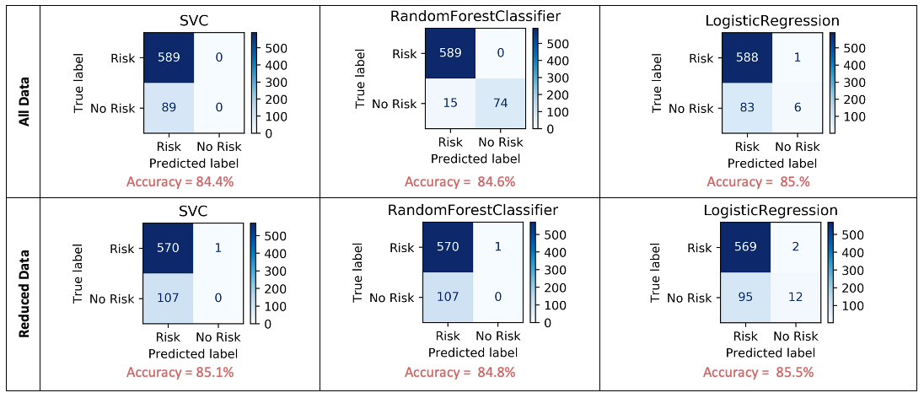
Final Model Results
Best Model
Notes:
Top performing models in each category

Slide 14
Final Conclusions from Analysis
Best model accuracy was achieved by removing prevalence of stroke and whether or not patient smokes
Accuracy of categorizations is ~85.5%
Recommendations for patient treatment based upon final categorization in resulting matrix

Slide 15
Proposed Future Work
The following are possible avenues to continue exploration using this data, but are out of current scope of work:
Build interactive Application to allow for entry of new patient data by physician for risk prediction
Build model to predict amount of risk and projected decline if recommendations for healthy lifestyle are followed
Build interactive application for patients to track improvements given recommendation plan and risk improvement/elimination
Additional opportunities are detailed in the report found here.

Slide 16

THANKS
Does anyone have any questions?
caitlinjejansson@gmail.com
https://github.com/CJEJansson/Springboard_Projects/Capsone2

Slide 17
REFERENCES
[ 1 ] https://www.thelancet.com/journals/lancet/article/PIIS0140-6736%2813%2961752-3/fulltext
[ 2 ] https://web.archive.org/web/20170710152157/https://www.framinghamheartstudy.org/index.php
[ 3 ] https://machinelearningmastery.com/a-tour-of-machine-learning-algorithms/
[ 4 ] https://scikit-learn.org/stable/modules/classes.html#module-sklearn.metrics
[ 5 ] https://towardsdatascience.com/cross-validation-430d9a5fee22

Slide 18
APPENDIX A:
Exploratory Data Analysis
and Statistics

Slide 19
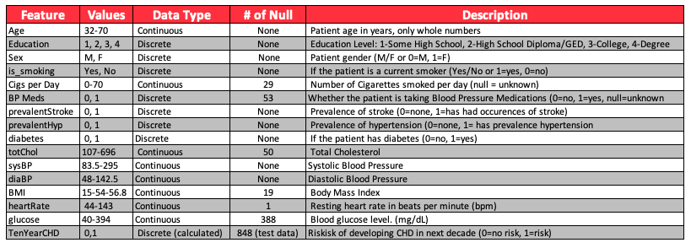
SUMMARY OF DATASET BY FEATURE

Slide 20
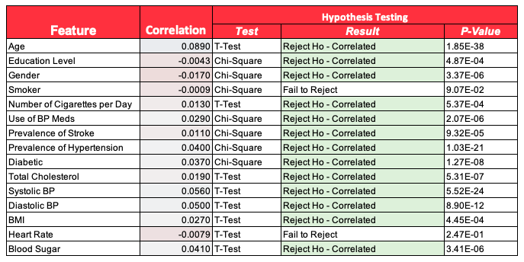
SUMMARY OF STATISTICAL ANALYSIS BY FEATURE

Slide 21
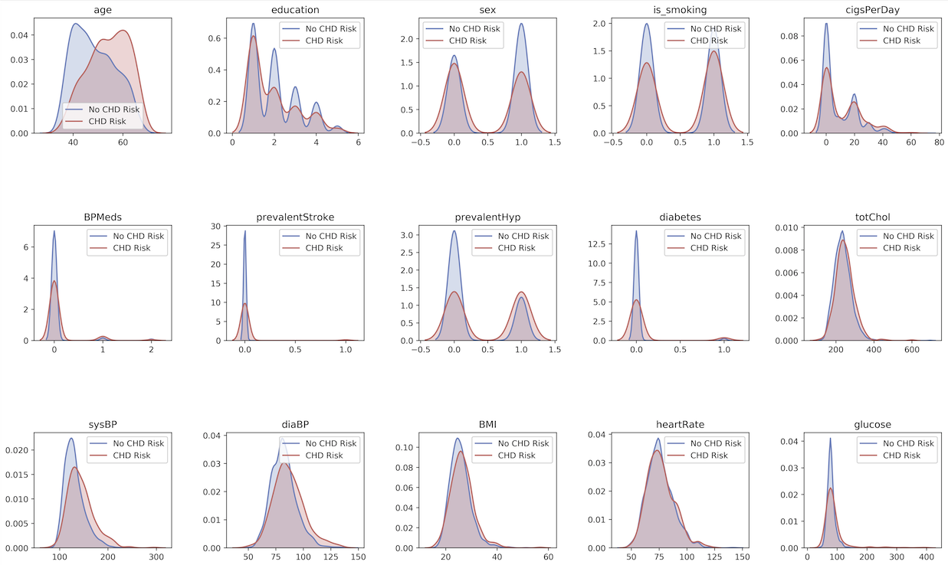
KDE Distributions by Feature vs Risk of Developing CHD

Slide 22
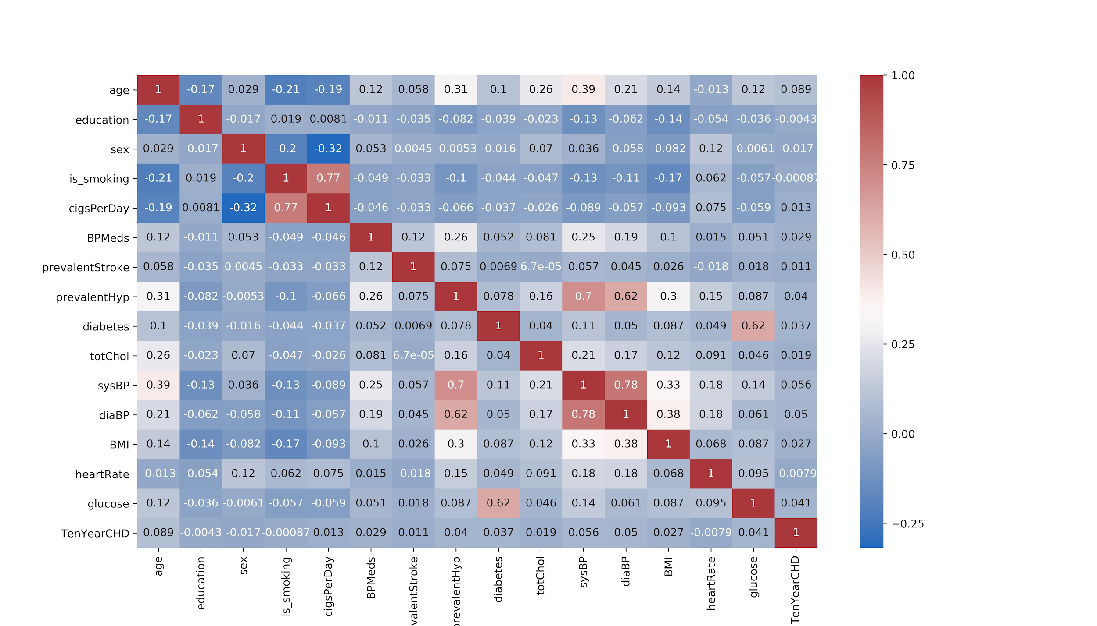
Full Correlation Heatmap

Slide 23
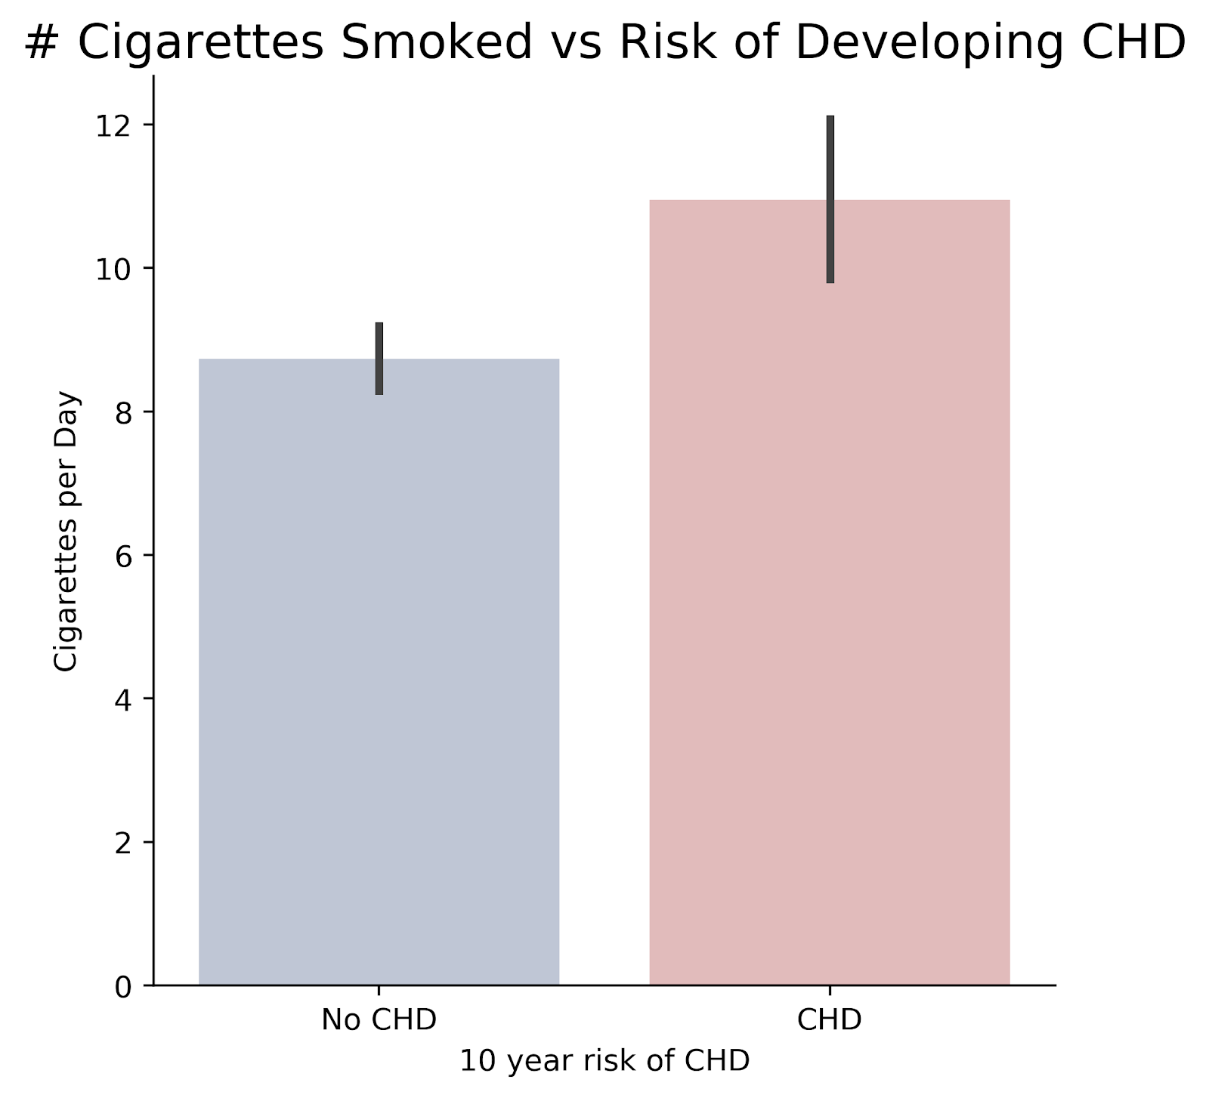
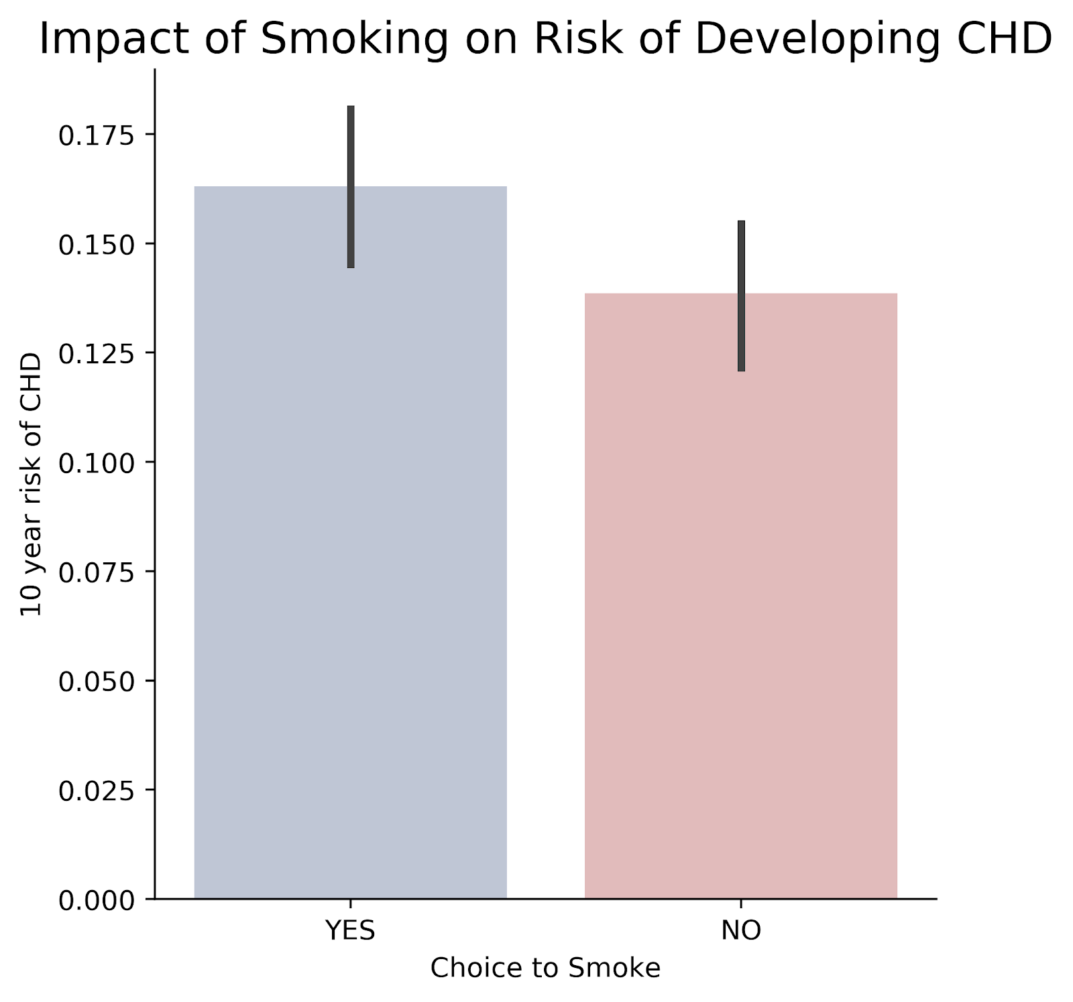
INITIAL FINDINGS: Smoking and CHD

Slide 24
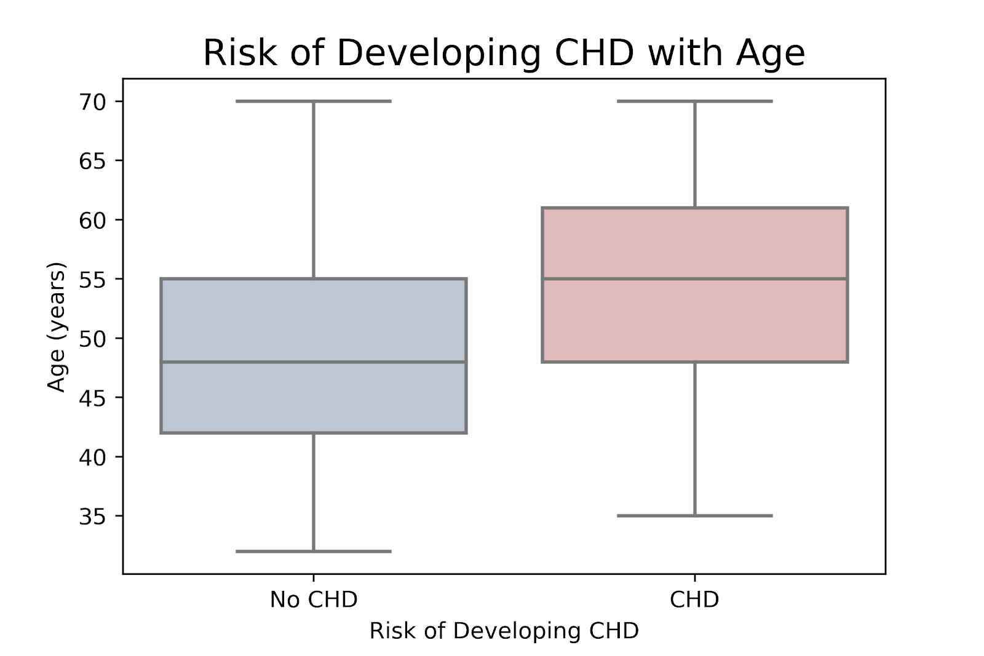
INITIAL FINDINGS: AGE AND CHD

Slide 25
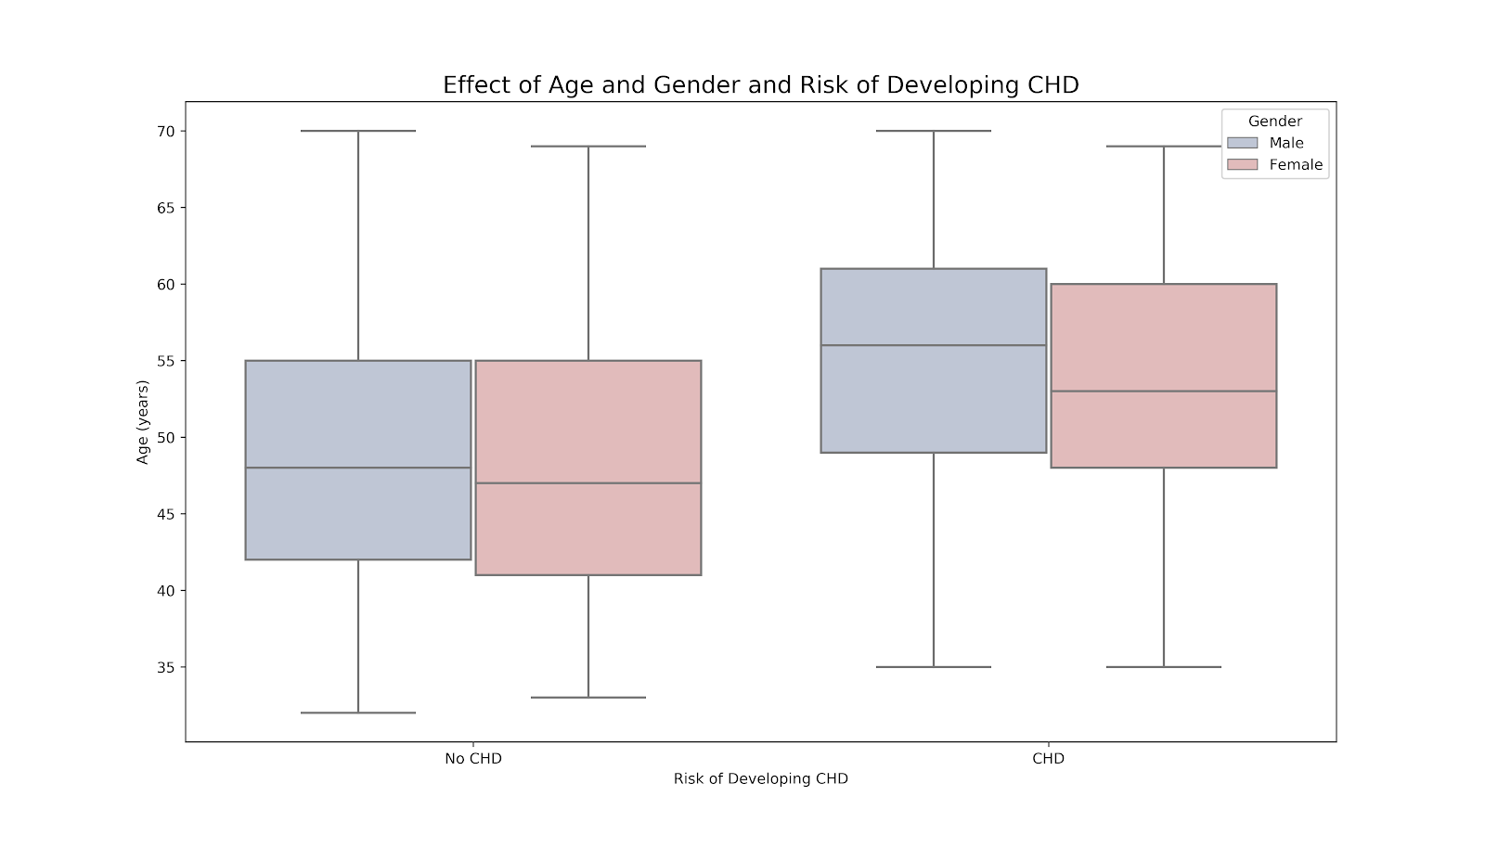
INITIAL FINDINGS: AGE, GENDER AND CHD

Slide 26
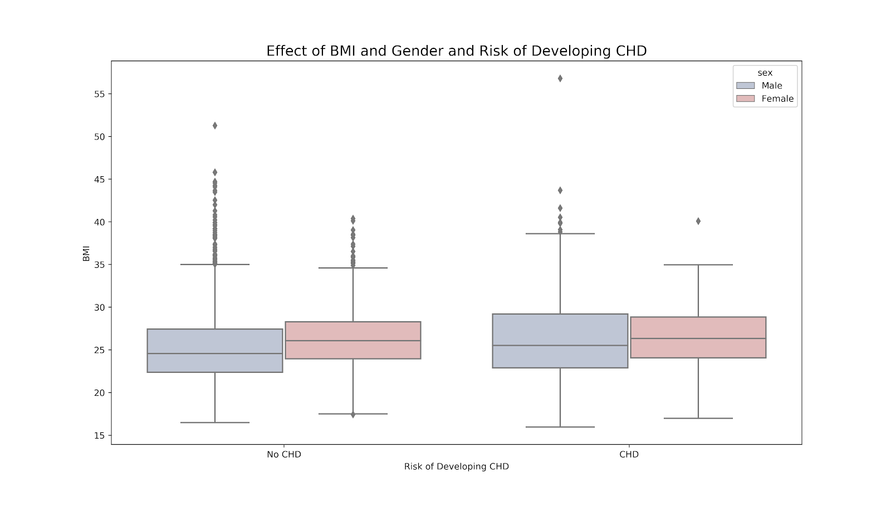
INITIAL FINDINGS: BMI, GENDER AND CHD

Slide 27
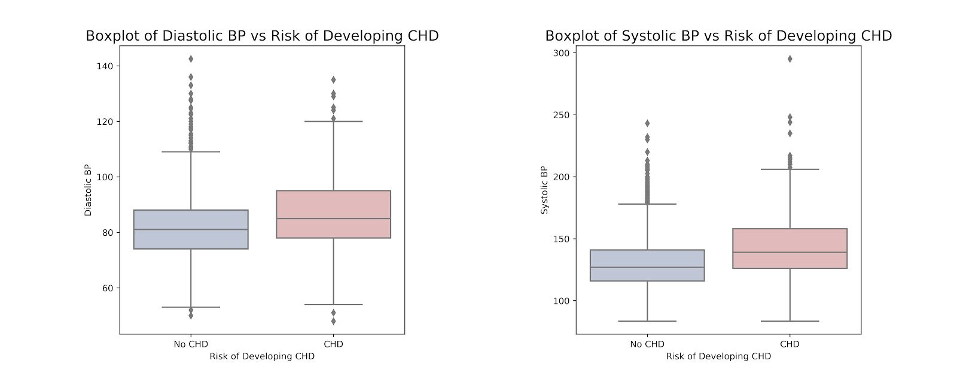
INITIAL FINDINGS: BLOOD PRESSURE AND CHD

Slide 28
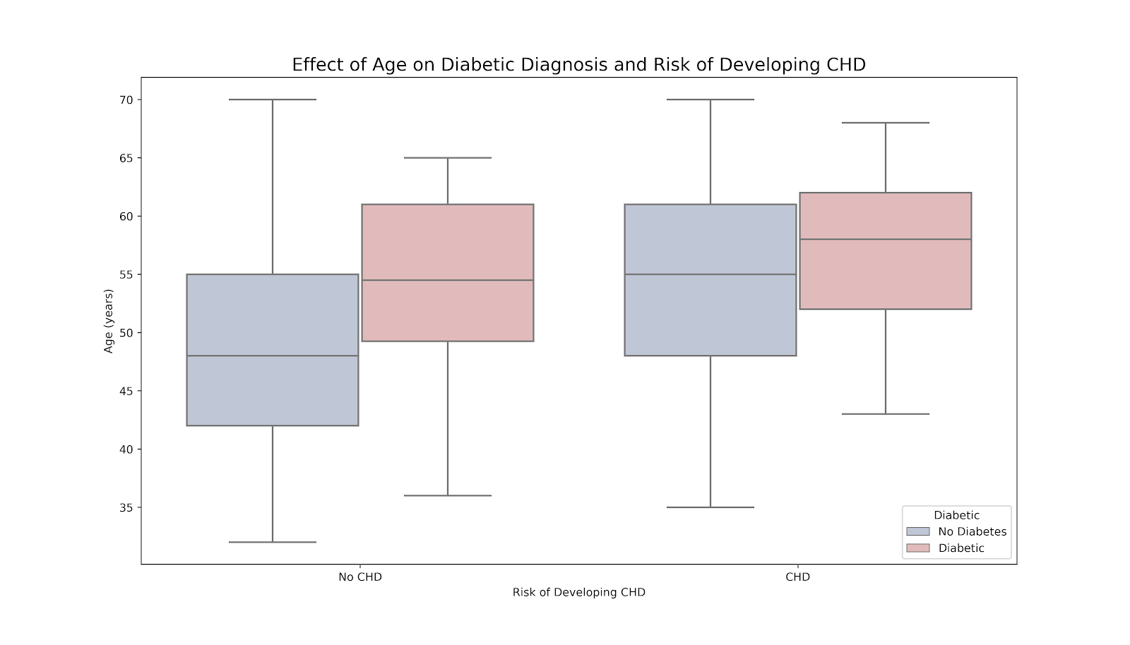
INITIAL FINDINGS: AGE, DIABETES AND CHD

Slide 29
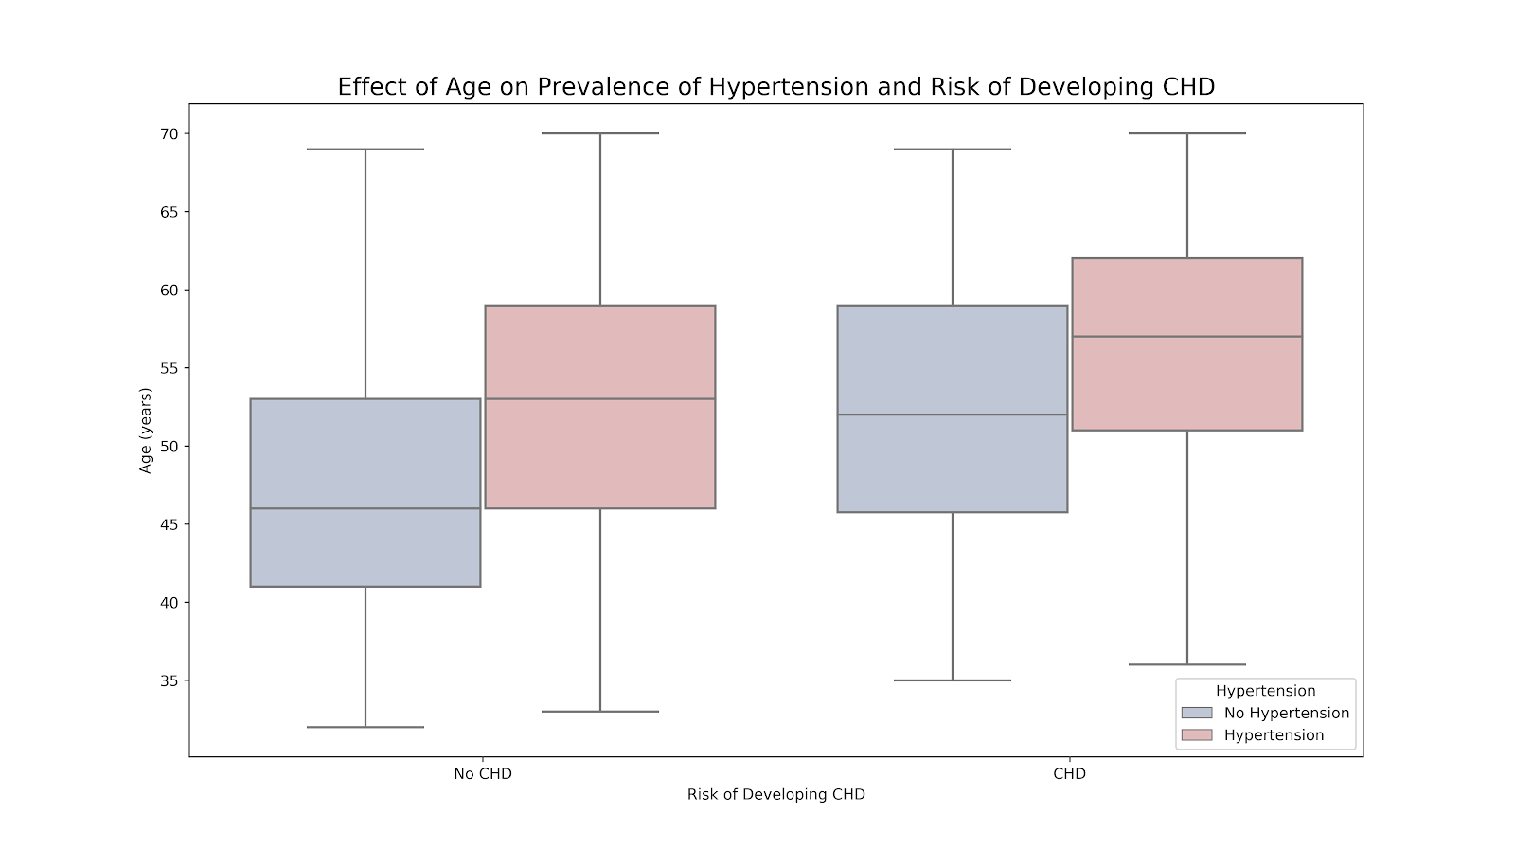
INITIAL FINDINGS: AGE, HYPERTENSION AND CHD

Slide 30
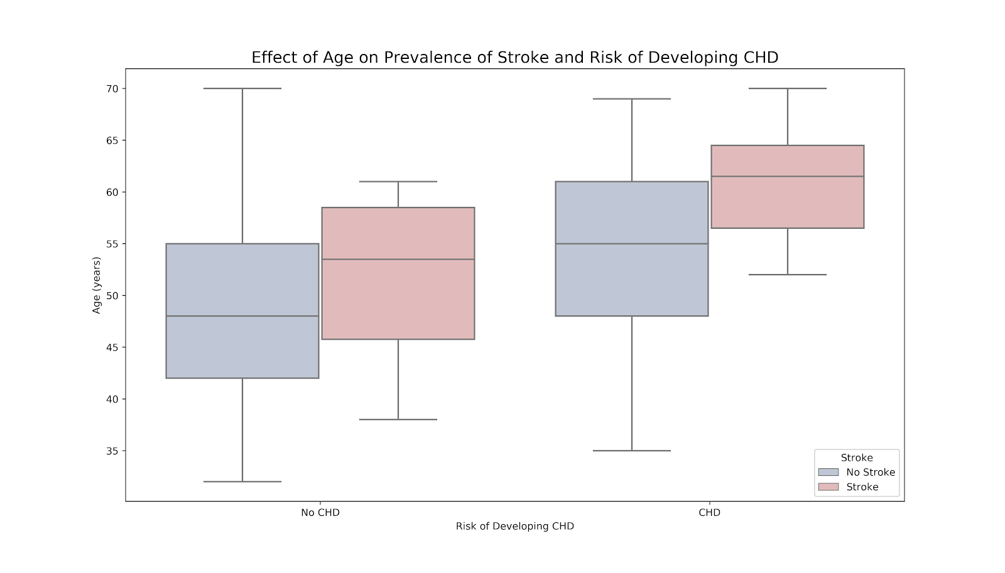
INITIAL FINDINGS: AGE, STROKE AND CHD

Slide 31
APPENDIX B:
Machine Learning

Slide 32
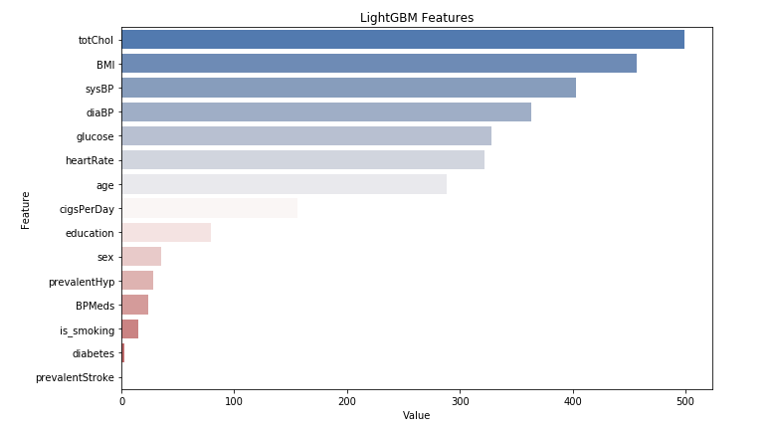
Light GBM Feature Selection

Slide 33
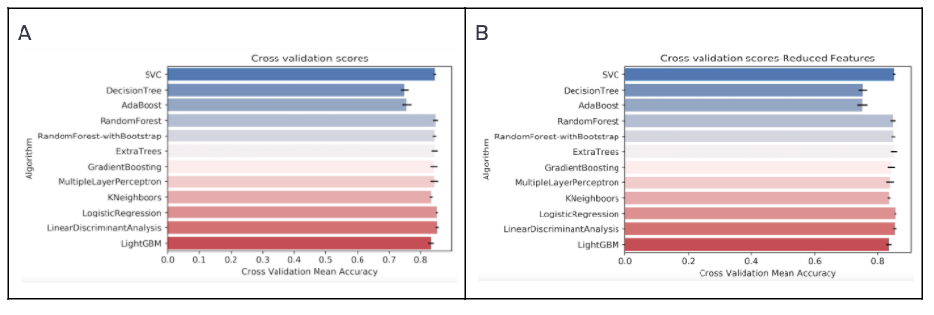
Cross Validation Accuracy Scores

Slide 34
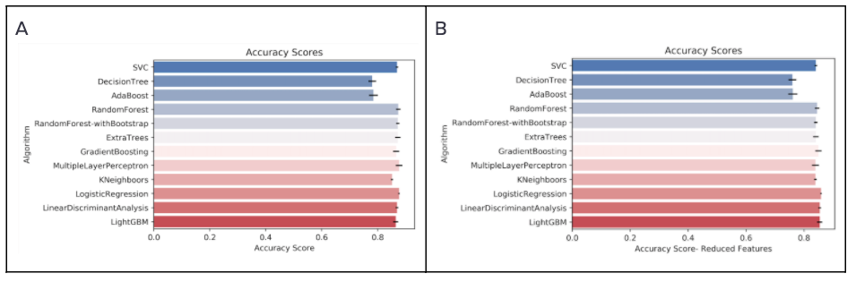
Accuracy Scores

Slide 35
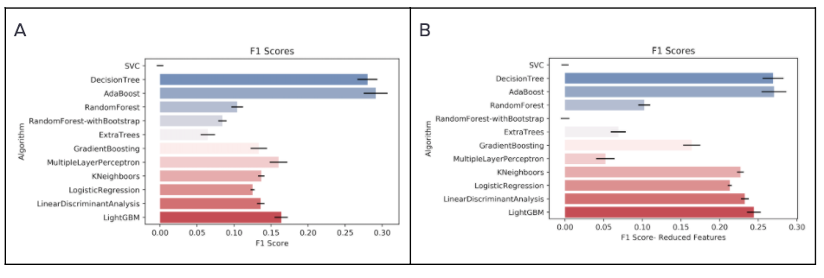
F1 Scores

Slide 36
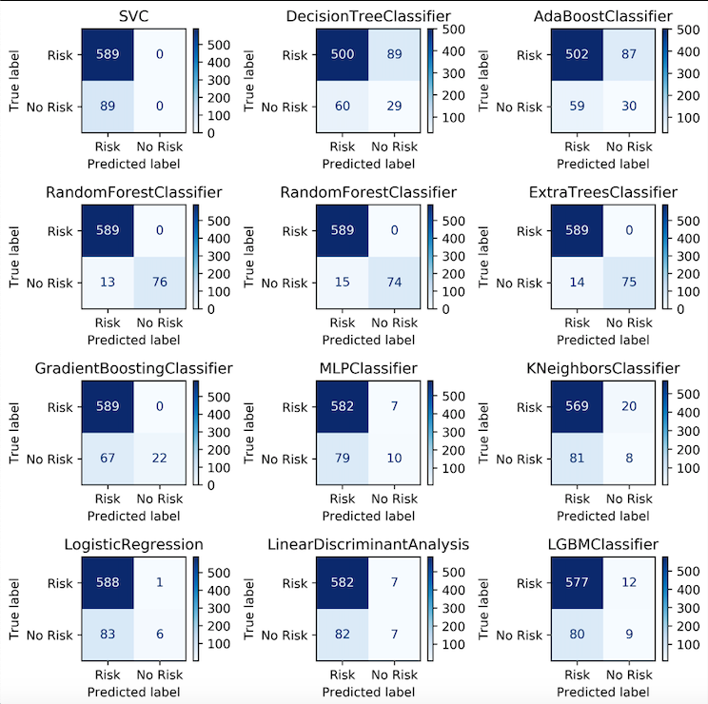
Confusion Matrices:
All Models, All Features

Slide 37
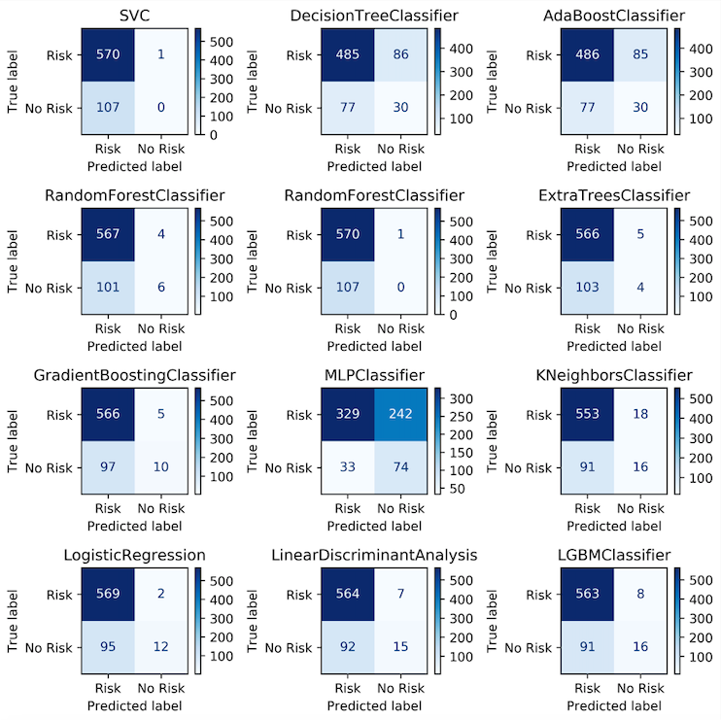
Confusion Matrices:
All Models,
Reduced Features

Slide 38
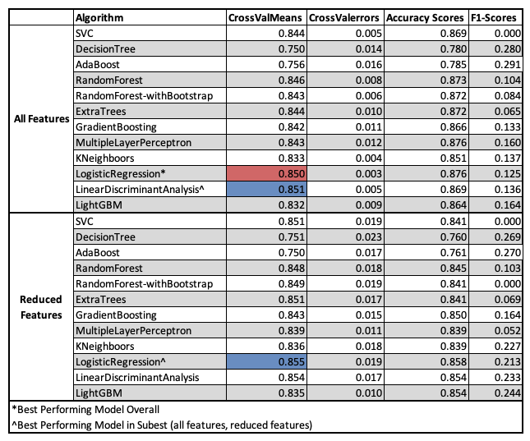
Summary of
Accuracy Scores:
All models

